Slide 1
Unit II
Investigate Process Methodologies

Slide 2
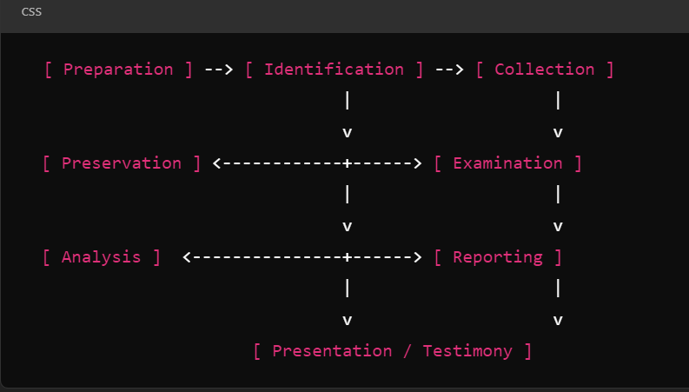
High-level Digital Forensic Process Model A high-level Digital Forensic Process Model provides a structured approach for conducting digital forensic investigations. The goal is to ensure that evidence is collected, analyzed, and presented in a manner that is legally acceptable and technically sound. Here’s a breakdown of the typical stages involved in a digital forensic process.

Slide 3
Preparation (Equip investigation with the necessary tools, skills and resources, establish procedures, policies, and legal considerations (e.g Warrant), and jurisdiction, and applicable laws). Identification (Identify potential digital evidence relevant to the investigation. Classify the data and digital devices like computers, mobile phones, cloud storage etc., that may contain evidence)

Slide 4
Collection Secure and acquire the identified digital evidence while ensuring its integrity. Creating bit-by-bit copies of hard drives. Ensure chain of custody is properly maintained and documenting every person who handle the evidence.

Slide 5
Preservation Ensure the integrity of the collected evidence and prevent tampering or degradation. Store the original evidence in a secure location to prevent accidental changes. Use hash values (e.g., MD5, SHA-256) to validate the integrity of the evidence over time.

Slide 6
Examination Systematically examine the digital evidence to identify relevant information's. Such as files, logs, emails, or deleted items. Recover deleted, hidden, or encrypted files. Use forensics tools to search for specific keywords, timestamps, metadata etc.,

Slide 7
Analysis Interpret the evidence to uncover relevant facts and patterns. Like network logs, hard drive content, mobile phone data. Reconstruct timelines of events, determine user actions and unauthorized access or malware activity.

Slide 8
Reporting Present findings in a structured, clear and legally defensible manner. Document the steps taken during the investigations, including tools used, methods followed and findings. Chain of Custody should be there on the trail evidence.

Slide 9
Presentation Provide the evidence and analysis to the appropriate parties, such a law enforcement, legal teams or courts. Present the evidence clearly and accurately, potentially including expert witness testimony. Explain technical concepts in a manner that is accessible to non-experts.

Slide 10
Technology and toolsets in the digital forensics' investigation: Digital forensics investigations require specialized technologies and tools to collect, preserve, analyze, and present digital evidence. These tools vary depending on the type of device, data, or crime being investigated.

Slide 11
Disk and files system forensics tools EnCase Forensics Forensic Toolkit (FTK) Autopsy Sleuth Kit ProDiscover Mobile Device Forensics Tools Cellebrite UFED, XRY, Oxygen Forensics and Magnet Axiom.

Slide 12
Network Forensics Tools Wireshark, Xplico, Netwitness, Network Miner. Memory Forensics Tools Volatility, Rekall, Belkasoft Live RAM Capturer, X-ways forensics, encase, ftk others Cloud Forensics Tools : Magnet Axiom Cloud, Google Vault, aws cloud forensics.

Slide 13
Email and Social Media Forensics Tools MailXaminer, Forensically, Magnet Axiom, FAW, X-social discovery. Malware Forensics Tools IDA Pro, Cuckoo Sandbox, REMnux. Password Cracking and Decryption tools Hashcat, John the Ripper, Passware Kit, ophcrack.

Slide 14
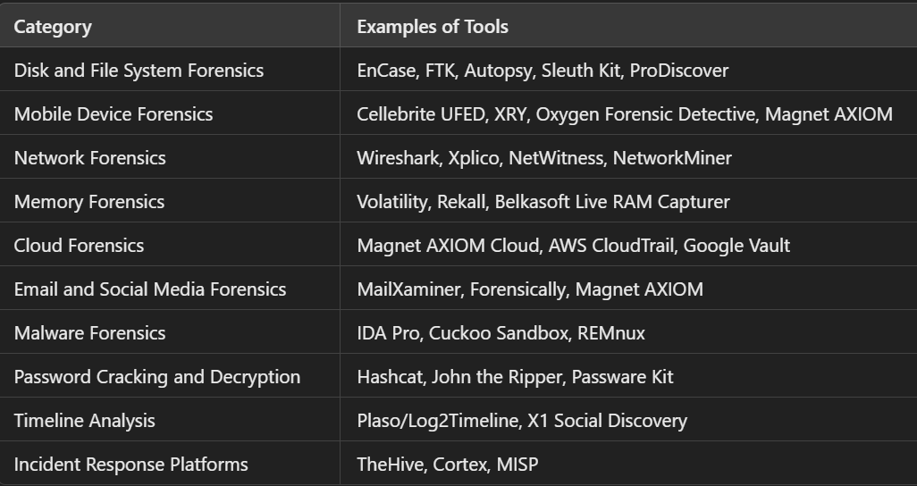

Slide 15
Securing the Scene Initial Response and scene safety like suspect device are located. Document the Scene like Photography. Isolate device from the network. Prevent data loss. Preserve volatile data Implement Chain of Custody Creating Forensic Imaging Bit-by-Bits Copies. Use Write Blockers, Conduct Investigation or Interview about scene.

